Slide 1
Peer Review of Teaching
Isabeau Iqbal, PhD
Educational Developer
UBC Centre for Teaching, Learning and Technology
This work is licensed under the Creative Commons Attribution-NonCommercial 4.0 International License.
To view a copy of this license, visit http://creativecommons.org/licenses/by-nc/4.0/.

Slide 2
Session Objectives
By the end of today’s session, you should be able to:
Distinguish between formative and summative peer review of teaching (PRT)
Describe at least 2 benefits of formative PRT
Explain the steps of a formative PRT
Identify some challenges in formative PRT and ways to address these challenges
Articulate your next steps for PRT (if any)

Slide 3
What it is…
Peer review of teaching: Collegial efforts to understand and describe teaching performance for the purposes of making improvements and/or fair decisions.
Chism, N. (2008-2009). Making sure that peer review of teaching works for you. Retrieved from: http://podnetwork.org/content/uploads/V20-N7-Chism.pdf

Slide 4
Two Models
Continuum of
Peer Review
Formative
Summative

Slide 5
Benefits
Individual benefits of formative PRT:
Professional growth in teaching
Collegial relationships
Less reliance on student evaluations of teaching
Reviewer learns

Slide 6
Benefits
Institutional benefits of formative PRT:
Teaching as a community endeavour
Collegial relationships
Less reliance on student evaluations of teaching
Improves faculty approaches to teaching)

Slide 7
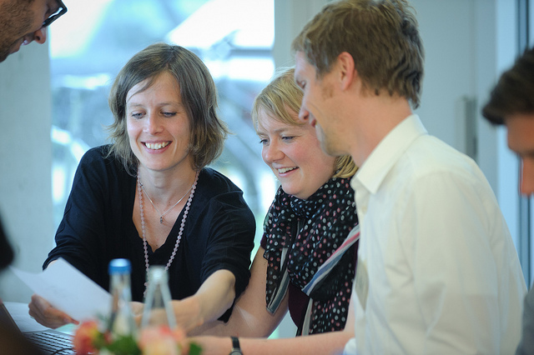
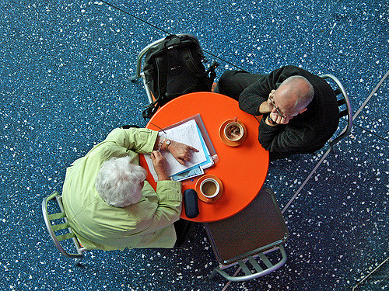
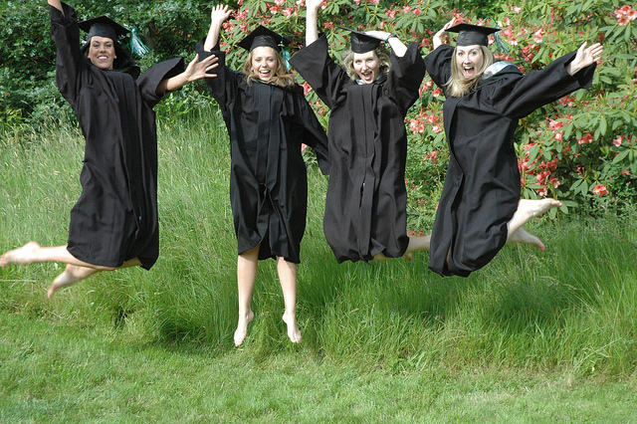
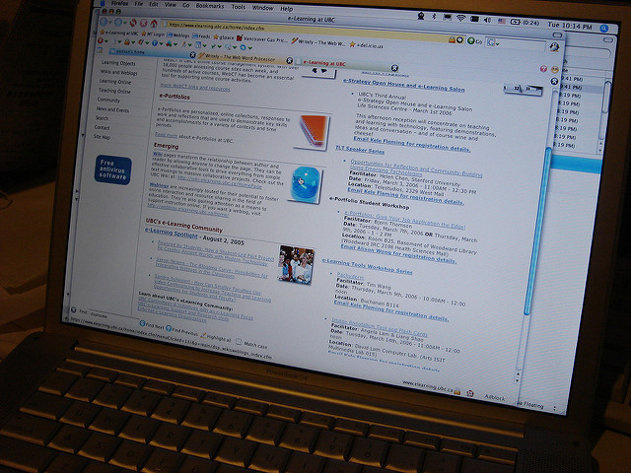
CTLT Program
Notes:
Since 2007
Formative peer review of teaching program
Skill building workshops
Online resources
Customized work with departments
Consultations with reviewers and reviewees
Formative peer review of teaching team
Graduate student peer review program

Slide 8
Process Overview
Reviewer-reviewee match up
Pre-observation meeting
Classroom observation
Post-observation meeting

Slide 9
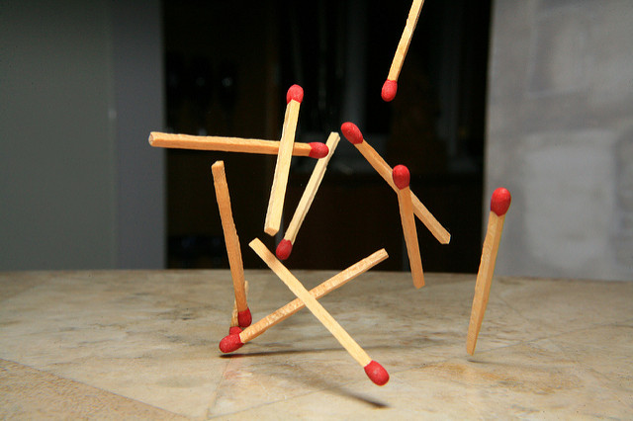
Review and Reviewee Match up

Slide 10
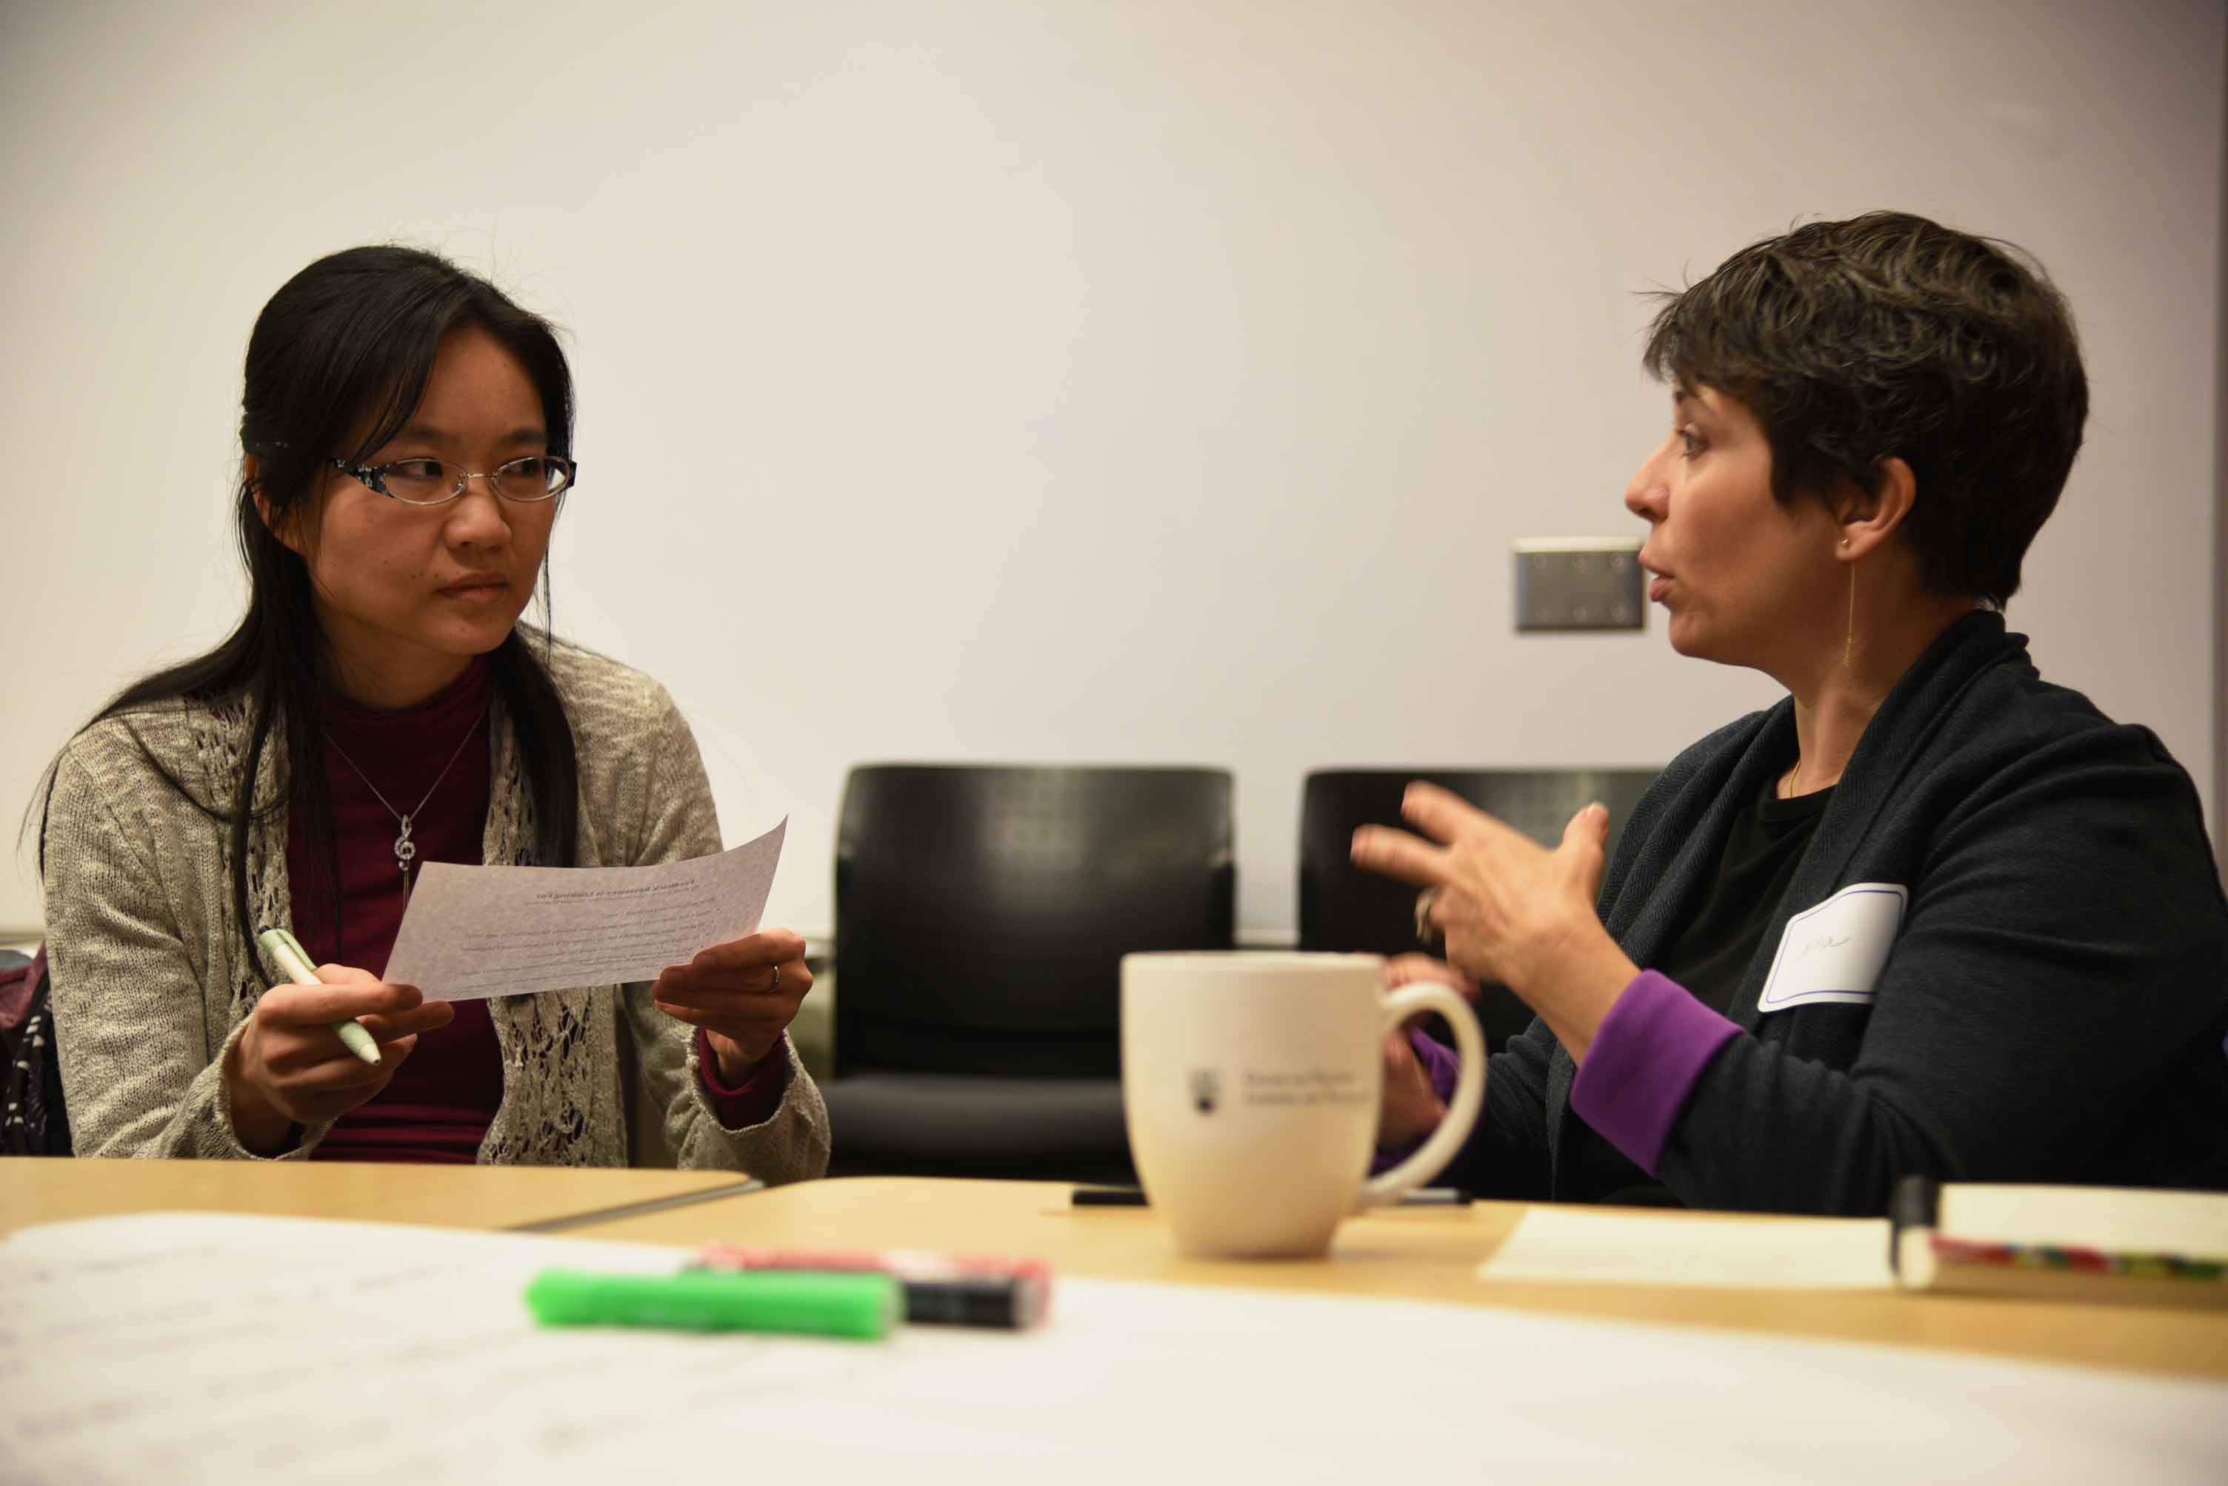
Pre-Observation Meeting
Photo: Emi Sasagawa

Slide 11
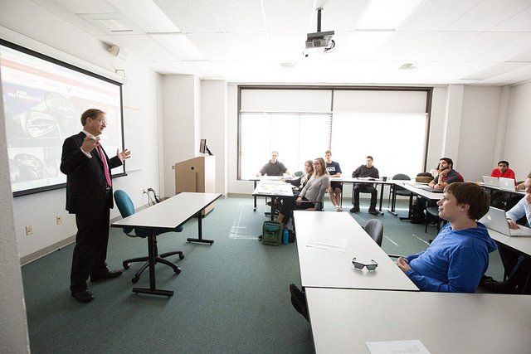
Observation
https://flic.kr/p/riMj4J

Slide 12
Post-Observation
https://flic.kr/p/6Lof3x

Slide 13
Reviewer-reviewee match up
Pre-observation meeting
Classroom observation
Post-observation meeting

Slide 14
Recommendations
Be clear about purpose (communicate to all)
Seek support of senior administrators
Consult others who have implemented PRT programs (literature etc)
Recognize that even a formative program can create anxiety among those being evaluated
Create documentation

Slide 15
Recommendations
Involve instructors and staff in design
Process should provide structure and guidance, but remain flexible
Provide training for reviewers
Point person needed
Consider how you will evaluate
Start small and local…”pilot”

Slide 16
Resources
CTLT’s Formative Peer Review of Teaching Program: http://ctlt.ubc.ca/programs/all-our-programs/peer-review-of-teaching-2/ (information about process and many resources)
Other good websites with resources:
http://www.adelaide.edu.au/teaching-projects/peerreview
http://www.flinders.edu.au/teaching/quality/evaluation/peer-review/peer-review_home.cfm
Collegial feedback on teaching: A guide to peer review (University of Melbourne)27 pages) http://www.cshe.unimelb.edu.au/resources_teach/feedback/docs/Peer_review_guide_web.pdf

Slide 17
References
Bernstein, D. J., Jonson, J., & Smith, K. (2000). An examination of the implementation of peer review of teaching. New directions for teaching and learning, (83), 73-86.
Chism, N. (2008-2009). Making sure that peer review of teaching works for you. Retrieved from: http://podnetwork.org/content/uploads/V20-N7-Chism.pdf
Chism, N. (2007). Peer review of teaching: A sourcebook (2nd ed.). Bolton, MA: Anker Publishing Company, Inc.
Nixon, S., Vickerman, P., & Maynard, C. (2010). Teacher immediacy: reflections on a peer review of teaching scheme. Journal of Further and Higher Education, 34(4), 491-502.
Woodman, A., Richard, J., & Maria, B. (2015). The effectiveness of peer review of teaching when performed between early-career academics. Journal of University Teaching & Learning Practice, 12(1), 2.
For more academic references, please see: http://wiki.ubc.ca/Documentation:CTLT_Resources/Peer_Review_of_Teaching_Academic_References

Slide 18
Photos
Photo credits on CTLT Program page:
“Workshop” https://flic.kr/p/9QSD52
“Two people – business meeting” https://flic.kr/p/6Lof3x
“University of the Fraser Valley” https://flic.kr/p/ceWrQY
“UBC e-learning” https://flic.kr/p/opS6d

Slide 19
Thank You
Please feel free to contact me for more information:
Isabeau Iqbal, PhD
isabeau.iqbal@ubc.ca
Website: isabeauiqbal.ca
Twitter: @isabeauiqbal

Slide 20
Feedback
1. The best part of today’s workshop for me was…. because…
^{2.} If I could change anything I would….
3. I also wanted to say/observe/suggest…

